Slide 1
CATHODE RAY TUBE
PREPARED BY
ALKA LEEKHA

Slide 2
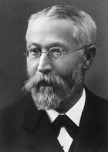
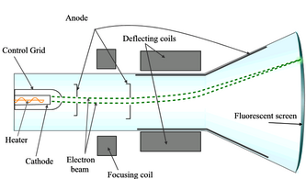
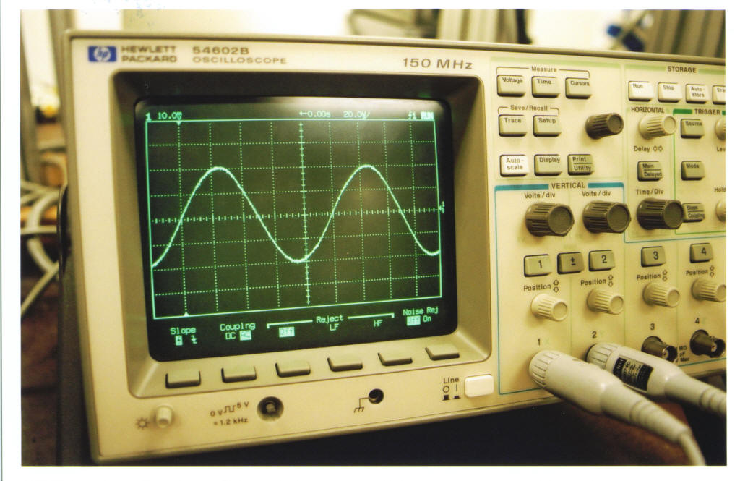
Monochrome Cathode Ray Tube
Invented in 1896 by Ferdinand Braun
First used for oscilloscopes, then for television, and finally for computers.
Philo Farnsworth developed the cathode ray tube that would be used for television and other electronic displays

Slide 3
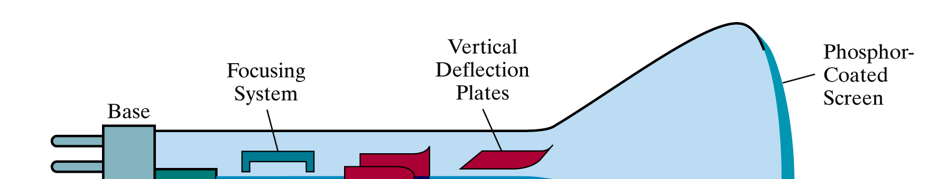
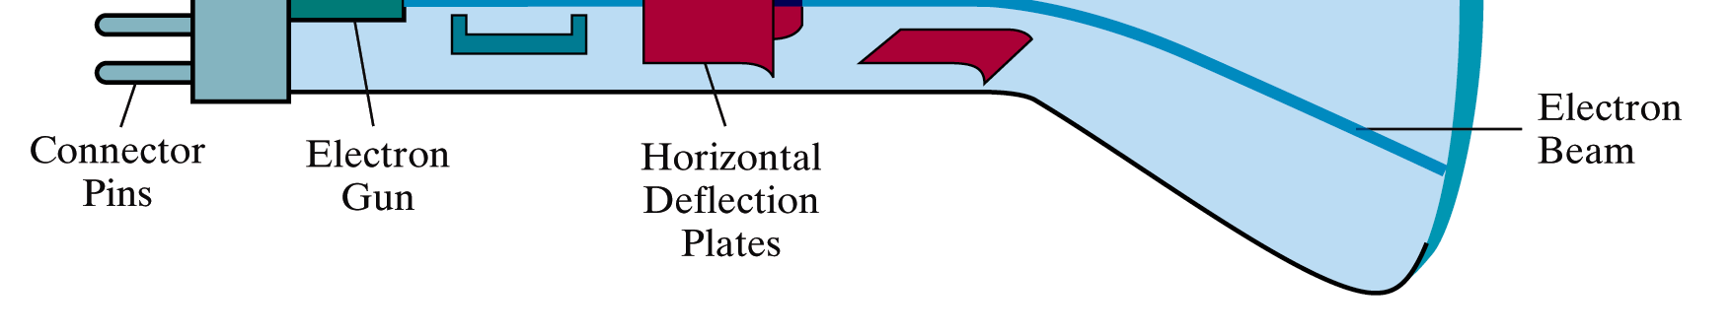
Cathode Ray Tube
The CRT uses an evacuated glass envelope which is large, deep, heavy, and relatively fragile.

Slide 4
What is cathode ray tube?
Cathode Ray
beam of electrons.
emitted by an electron gun.
accelerated by a high positive voltage near the face of the tube.
forced into a narrow stream by a focusing system.
directed toward a point on the screen by the magnetic field.
generated by the deflection coils.
hit onto the the phosphor-coated screen.
phosphor emits visible light, whose intensity depends on the
number of electrons striking on the screen.

Slide 5
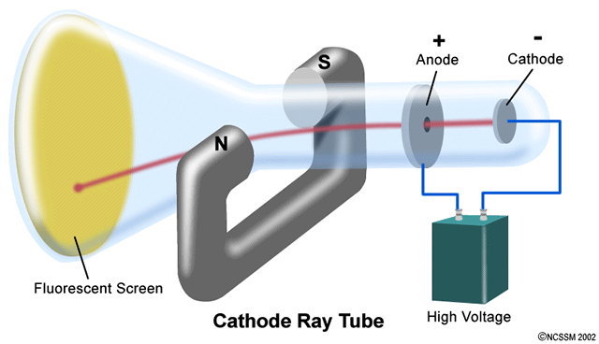
How CRTs work & display?
A CRT monitor contains millions of tiny red, green, and blue phosphor dots that glow when struck by an electron beam that travels across the screen to create a visible image.
In a CRT monitor tube, the cathode is a heated filament.
The heated filament is in a vacuum created inside a glass tube.
The electrons are negative and the screen gives a positive charge so the screen glows.

Slide 6
Phosphor persistence
Various phosphors are available depending upon the needs of the measurement or display application.
The brightness, color, and persistence of the illumination depends upon the type of phosphor used on the CRT screen.
Phosphors are available with persistence's ranging from less than one microsecond to several seconds.
For visual observation of brief transient events, a long persistence phosphor may be desirable.
For events which are fast and repetitive, or high frequency, a short-persistence phosphor is generally preferable.

Slide 7
Color CRTs
Color tubes use three different phosphors which emit red, green, and blue light respectively. Color CRTs have three electron guns, one for each primary color, arranged either in a straight line or in a triangular configuration (the guns are usually constructed as a single unit). A grille or mask absorbs the electrons that would otherwise hit the wrong phosphor. A shadow mask tube uses a metal plate with tiny holes, placed so that the electron beam only illuminates the correct phosphors on the face of the tube.
The three beams in color CRTs would not strike the screen at the same point without convergence calibration. Instead, the set would need to be manually adjusted to converge the three color beams together to maintain color accuracy.

Slide 8
Advantages of CRT
The cathode rayed tube can easily increase the monitor’s brightness by reflecting the light.
They produce more colours
The Cathode Ray Tube monitors have lower price rate than the LCD display or Plasma display.
The quality of the image displayed on a Cathode Ray Tube is superior to the LCD and Plasma monitors.
The contrast features of the cathode ray tube monitor are considered highly excellent.

Slide 9
Disadvantages of CRT
They have a big back and take up space on desk.
The electromagnetic fields emitted by CRT monitors constitute a health hazard to the functioning of living cells.
CRTs emit a small amount of X-ray band radiation which can result in a health hazard.
Constant refreshing of CRT monitors can result in headache.
CRTs operate at very high voltage which can overheat system or result in an implosion
Within a CRT a strong vacuum exists in it and can also result in a implosion
They are heavy to pick up and carry around

